Slide 1
BE PROJECT CUSTOMER CLASSIFICATION PREDICTION MODEL FOR ONLINE STORE
Team Member 1: Arhanti Gawde
Team Member 2: Arpita Hirlekar
Team Member 3: Snehal Surve
Project Guide: Prof. Pravin Adivarekar

Slide 2
OBJECTIVE
The objective of this project is to build a model that will classify customers based on the basis of some parameters and give them recommendations accordingly and provide a comprehensive framework for the efforts taking place in direct marketing strategy.
The company will be benefited because it will send recommendation only to customers who are likely to revert to the recommended product.

Slide 3
PROBLEM STATEMENT
To generate a model that will classify customers on some constraints and make clusters of customers to give appropriate recommendations to particular clusters.
All customers in a cluster will be given the same recommendations which will be relevant to their selection of clothes.

Slide 4
INTRODUCTION
There are two methods of advertisements and promotions, namely mass marketing and direct marketing.
Mass marketing results in high wastage and low response rate from the customers who will actually buy the product. Hence, this is not an effective method to be applied in today’s competitive market.
Therefore, rather than going forward with such an unreliable method, the marketers are now shifting their focus from traditional Mass marketing to Direct marketing.
Direct marketing uses data mining techniques with the help of which classification is done which is the most important factor for direct marketing.

Slide 5
LITERATURE REVIEWED
Base IEEE paper : T. K. Das, “A Customer Classification Prediction Model Based on Machine Learning Techniques”
Papers referred :
K. Wisaeng, “A Comparison of Different Classification Techniques for Bank Direct Marketing”.
Hany. A. Elsalamony, Alaa. M. Elsayad, “Bank Direct Marketing Based on Neural Network”
Lilian Sing’oei1 and Jiayang Wang,”Data Mining Framework for Direct Marketing: A Case Study of Bank Marketing”.
Eniafe Festus Ayetiran,“A Data Mining-Based Response Model for Target Selection in Direct Marketing”.

Slide 6
PROPOSED SYSTEM
In our project we will be classifying customers who are using our website in divergent clusters based on their liking. Customers will be put in particular cluster based on some constraints like similar shopped items, viewed items or items in their cart.
In the IEEE paper that we have selected, they focus on three mostly used classification algorithms namely Naïve Bayesian, K Nearest Neighbor and Support Vector Machines to a bank customer dataset.
In the reference papers it can be seen that various authors have used different machine learning algorithms.

Slide 7
On analyzing the reports and results from the reference papers, it was observed that Naïve Bayesian classification achieves the highest accuracy in the context of existing back customer data set. In our project we are doing it for an online shopping website related to clothing.
After classification we come to the next important part which is recommendation of products. Here, recommendation about a new product will be given to all the customers in a cluster who will most likely respond to the new offering.

Slide 8

Domain Understanding (business knowledge)
Data collection (collect data from website)
Data preprocessing (ETL, data cleaning, attribute selection)
Model construction (Classification – Naïve Bayes)
Analysis (classification done – recommendation)
Reporting

Slide 9
FLOW OF MODULES
DOMAIN UNDERSTANDING
In any business it is a challenge to figure out the exact knowledge of the business for it to be successful.
The domain of this project involves online shopping and classification of its customers. Hence, it is important to understand the environment of the website and its marketing strategy.

Slide 10
DATA COLLECTION
Data collection is the process of gathering and measuring data, information or any variables of interest in a standardized and established manner.
Usually initial and integral component in data mining is data collection which depends on environment of the domain. The primary goal of any data collection is to capture quality data or evidence.
Data collection in our project is the data of users which we will collect from our website.

Slide 11
DATA PREPROCESSING
Data cleaning- Adjustments are made according to the addition or deletion of items in the cart. Also, duplication of data is removed.
ETL- First the extract function reads data from our website and loads the transformed data in the database.
Attribute selection- Different categories of clothes are the various attributes that are to be selected.

Slide 12
MODEL CONSTRUCTION
This step involves application of Data Mining techniques on the data to discover the interesting patterns.
Since our project deals with classification of customers, we will be applying classification algorithms to the obtained dataset.
Out of the classification techniques Naïve Bayes classification technique has been selected for this project.

Slide 13
ANALYSIS
The analysis stage is the stage at which data is finally usable. It involves visualizing the data in a very clear and understandable way.
The classification done in previous stages will result in various categories. In this step we will decide what and how recommendations have to be given to specific groups.

Slide 14
REPORTING
Data reporting is the part of a system that reports key elements relating to an organizations’ performance in order to improve different aspects.
After observing data gathered for a certain period of time, we can make changes in what recommendations we give and the way we are giving it.

Slide 15
TECHNOLOGY STACK
FRONT END
HTML 5- HTML is the standard markup language that allows users to create and structure sections, headings, links, paragraphs, and more, on a website using various tags and elements.
CSS 3- CSS is the language that describes the style of an HTML document. we are using CSS3 which introduces new selectors and properties that allow for more flexibility with page layout and presentation.
JAVASCRIPT- It is a scripting language for web pages for converting static pages to dynamic.

Slide 16
BACK END
MySQL WORKBENCH - MySQL Workbench is a visual database design tool. The activities performed on the website by the user will be collected in the MySQL Workbench. This workbench will then produce a dataset of the our website.
GOOGLE COLAB - used to create a machine learning model. Platform for writing and executing the code, saving the analysis. This Colab will use the dataset produced by the workbench and the machine learning program to give classification as the output.

Slide 17
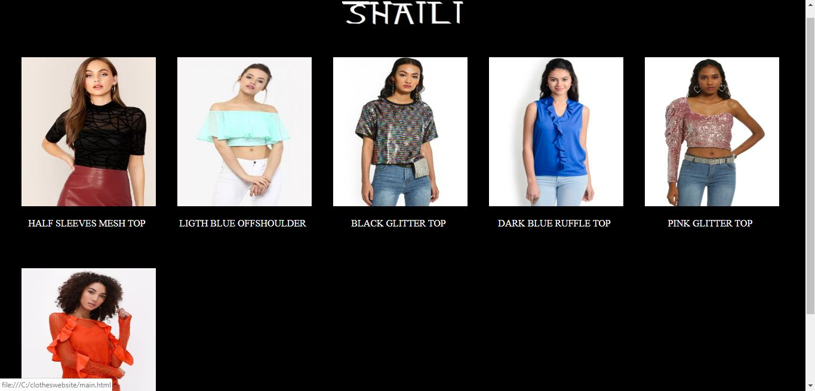

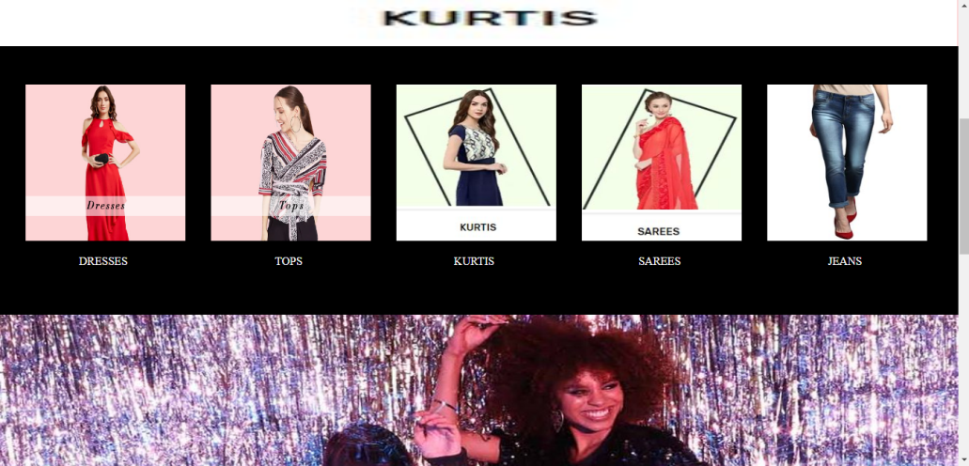
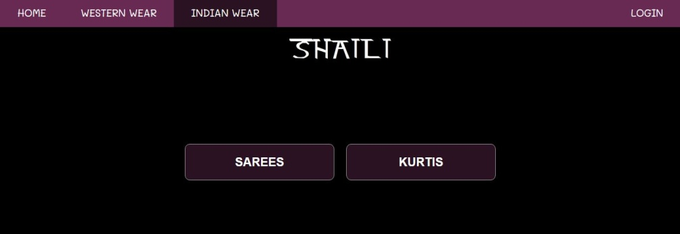
WORK DONE TILL NOW

Slide 18
APPLICATIONS
The classification of customers will help to convey specific and helpful information about clothes to customers by giving them relevant recommendations so that our sale increases by attracting them towards such products.
Recommending to particular group of customers on the website lets them know we appreciate them for visiting and shopping from our website. These customers will recommend our products to different people resulting in increase in sale and thereby giving profit.

Slide 19


